Slide 1
Overview of Logistics
(boring things are important too)

Slide 2
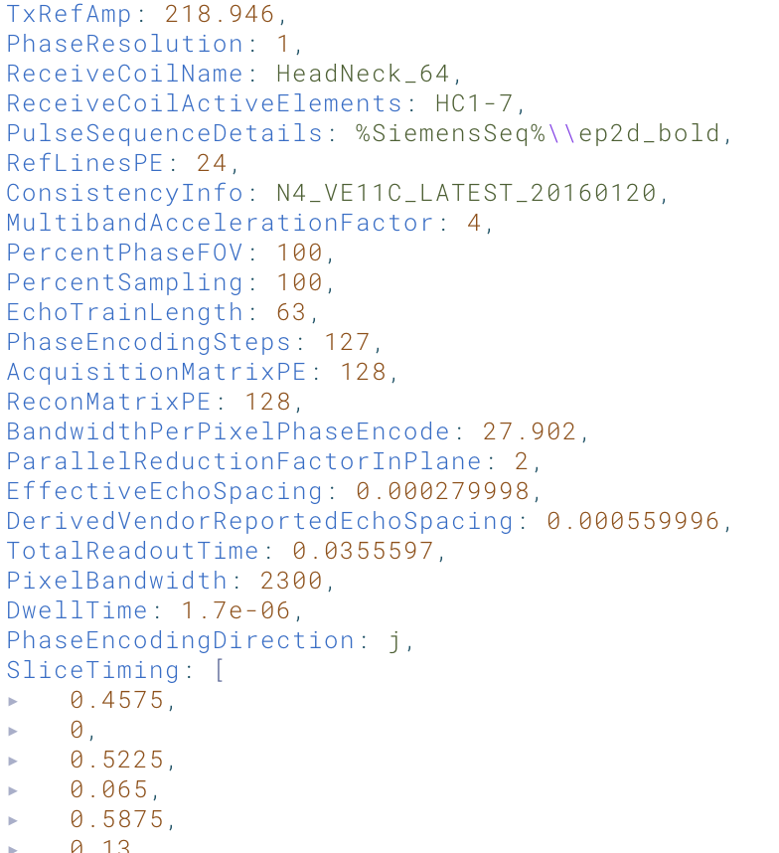
Necessary File Types
DICOM (Digital Imaging and Communications in Medicine)
“.dcm”
NIfTI (Neuroimaging Informatics Technology Initiative (NIfTI)
“.nii” or “.nii.gz” when compressed
JSON (JavaScript Object Notation)
“.json”
Notes:
DICOM: folders of files produced by the scanner. Not efficient for computational expensive data processing
NIfTI: community standard for neuro data
- provides minimal metadata like orientation information
JSON: human readable dictionary for storing metadata

Slide 3
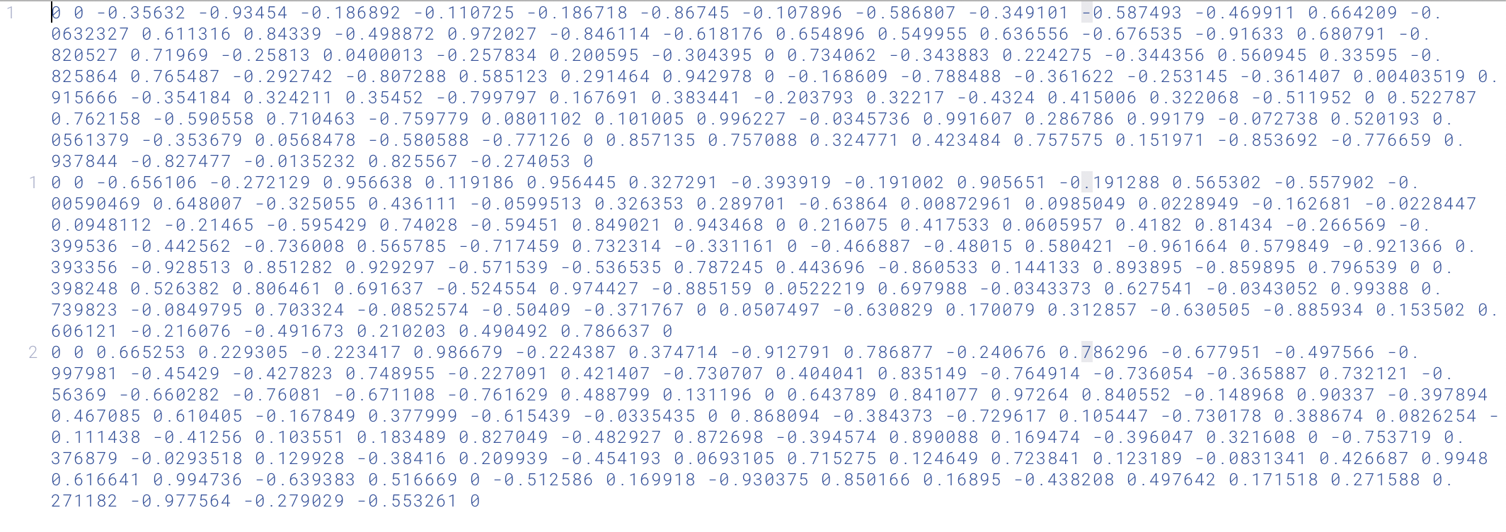
Necessary File Types: DWI Specific
B-Values
“.bvals”
B-Values
“.bvals”
B-Vectors
“.bvecs”
Notes:
Bvals: magnitude of diffusion gradient
Bvecs: triplet representation of gradient direction for each image

Slide 4
Files before processing
T1-weighted image file (NIfTI)
T1-weighted image metadata (JSON)
DWI file (NIfTI)
DWI metadata (JSON)
B-vectors file
B-values file
Field map AP (NIfTI)
Field map AP metadata (JSON)
Field map PA (NIfTI)
Field map PA metadata (JSON)

Slide 5
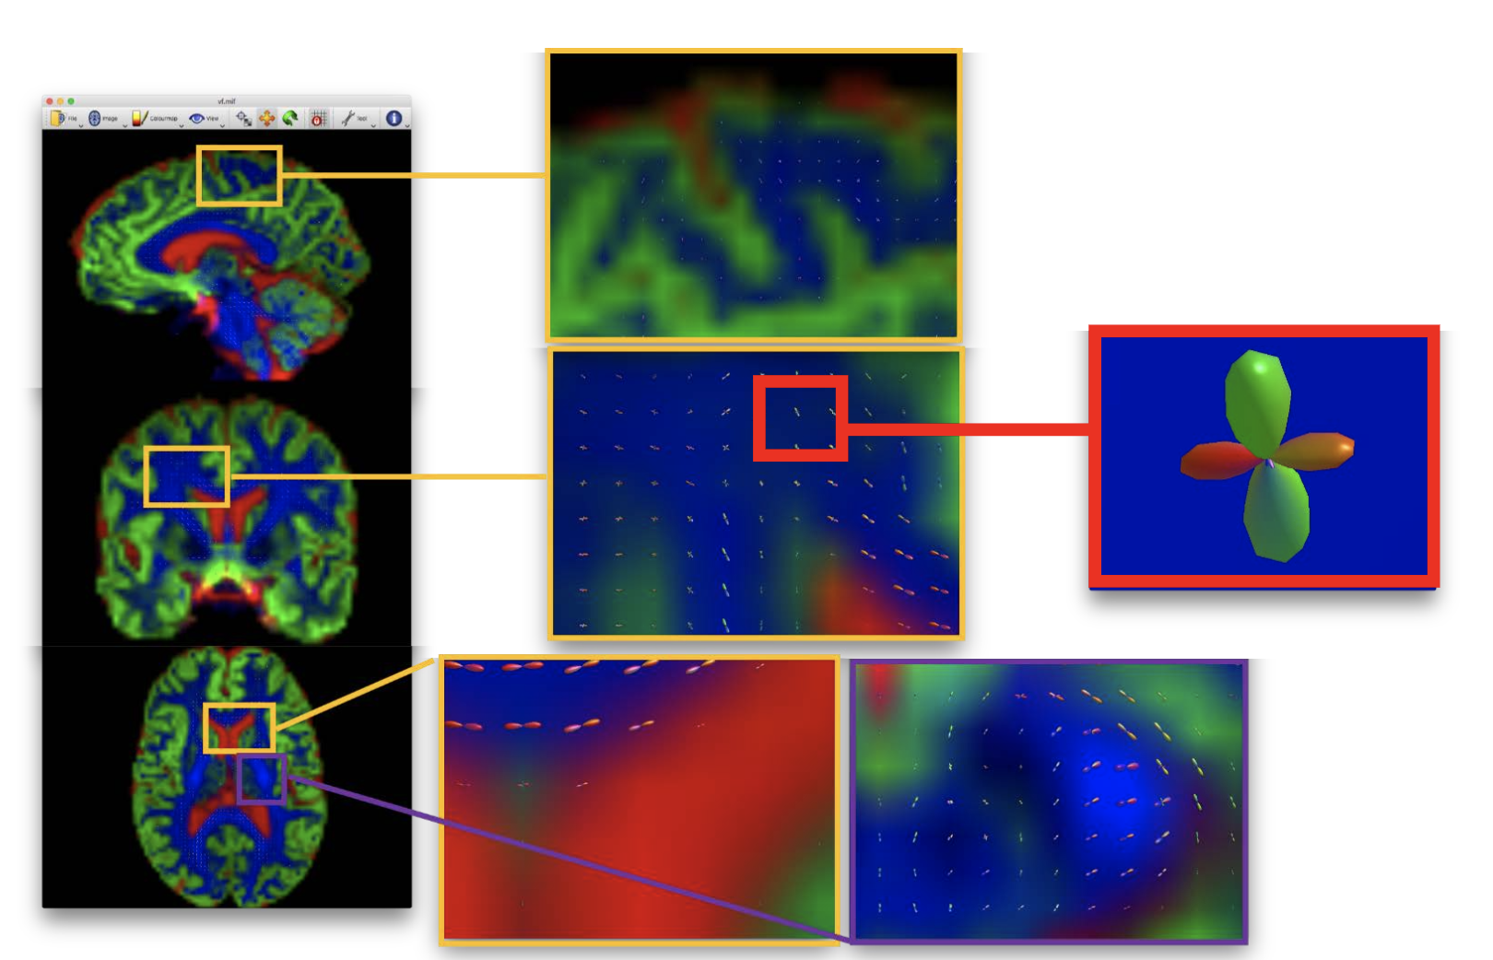
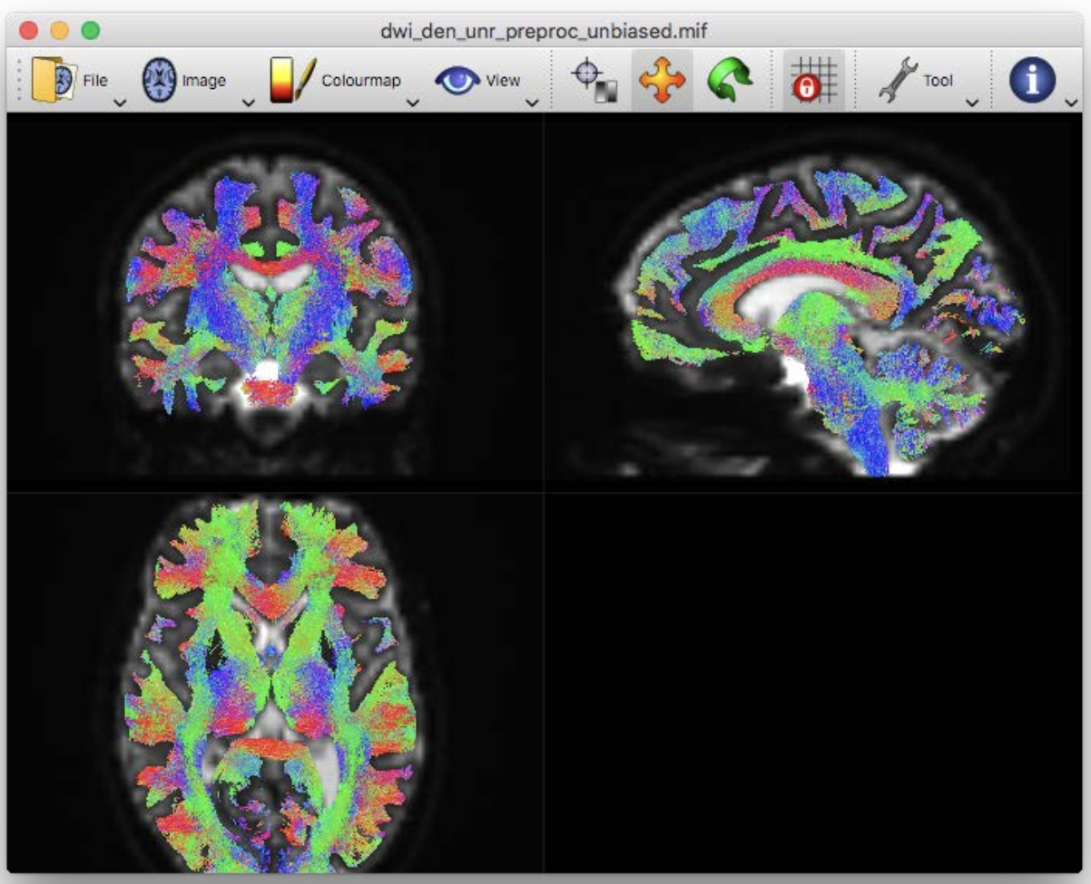
Tools and Derivatives: MRtrix (Tournier et al., 2019)
MIF (MRtrix-specific Image Format)
“.mif”/“.mif.gz” and “.mih” (separated header file)
Track file formats
“.tck” and “.tcs”
Notes:
“mif”: allows optimizing strides (distance between relevant stored data). Helps with improving access to different types of data
fixel – a specific fibre bundle within a specific voxel

Slide 6
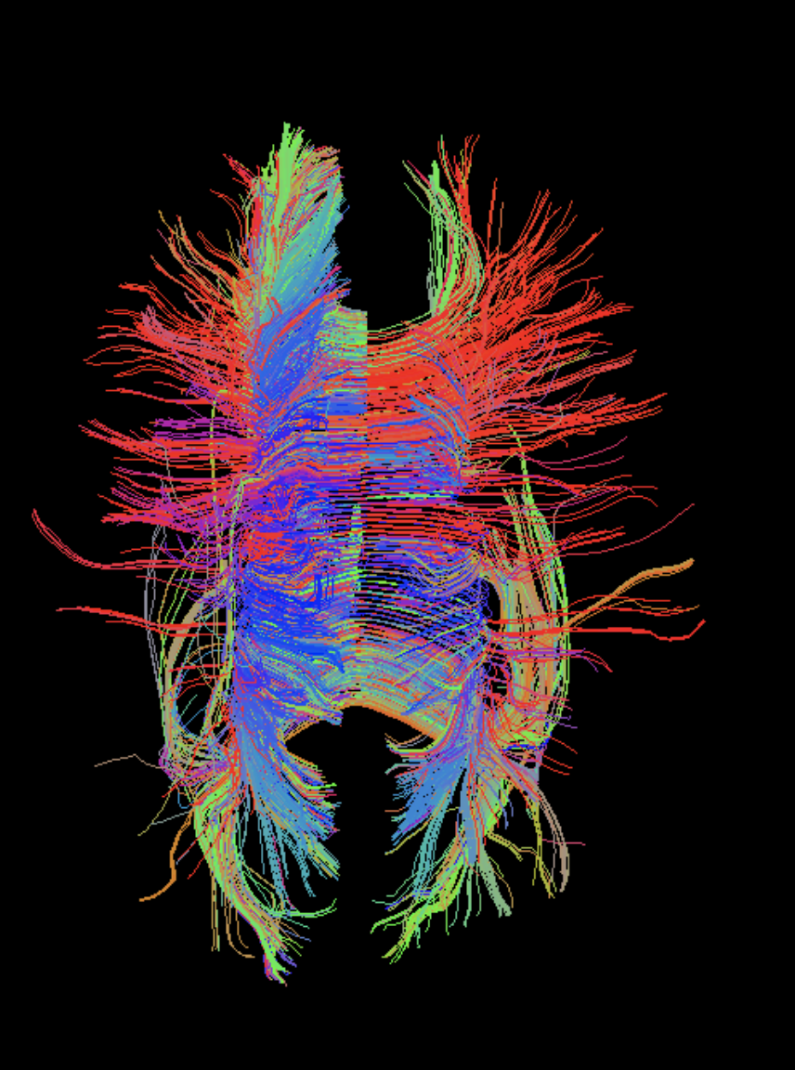
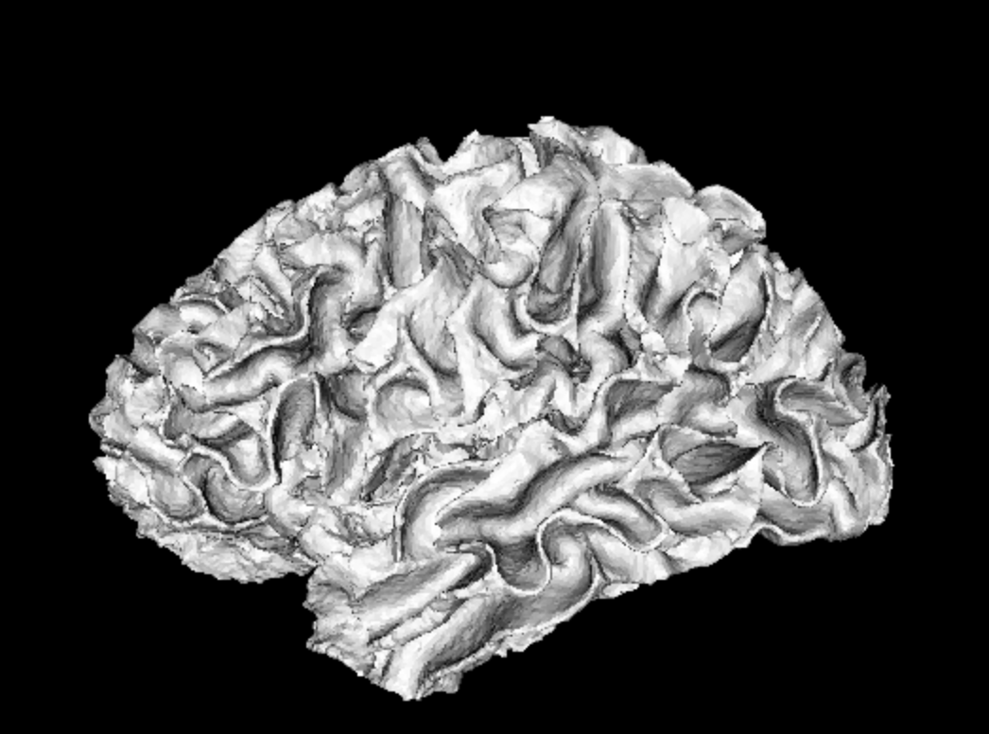
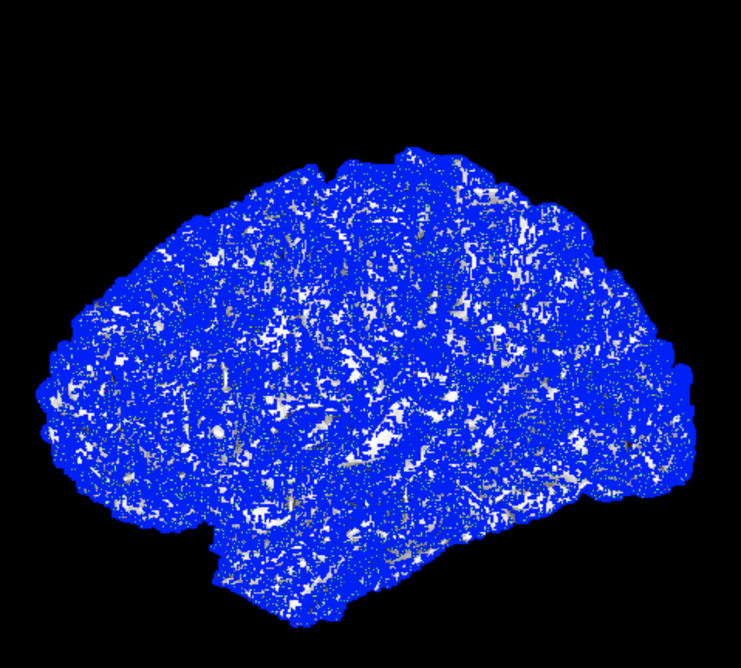
Tools and Derivatives: DIPY
Tractogram - “.trk”
DPY – “.dpy”
General VTK support
Notes:
Trk : not made by dipy but used
DPY is just hdf5 with a new file extension
Last example is surface seeding tutorial. Meshes like these typically require more complex support than we natively have in neuro specific formats

Slide 7
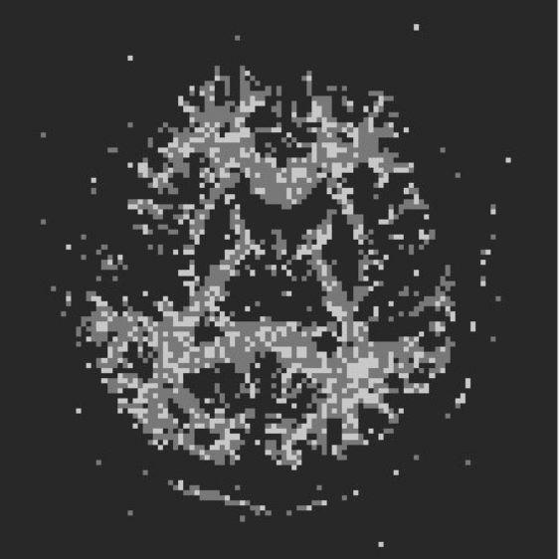
Tools and Derivatives: Camino (Cook et al., 2006)
Scheme (“.scheme”) files for storing b-vectors and b-values
DT: diffusion tensor fit
Multitensor (multiple fits per voxel)
PDs: peak directions
DTEig: DTI eigne system
Streamline fiber tract: vector of x, y, z coordinates
Streamline VTK object: because there isn’t enough to figure out already
Notes:
A file for every single thing you could do

Slide 8
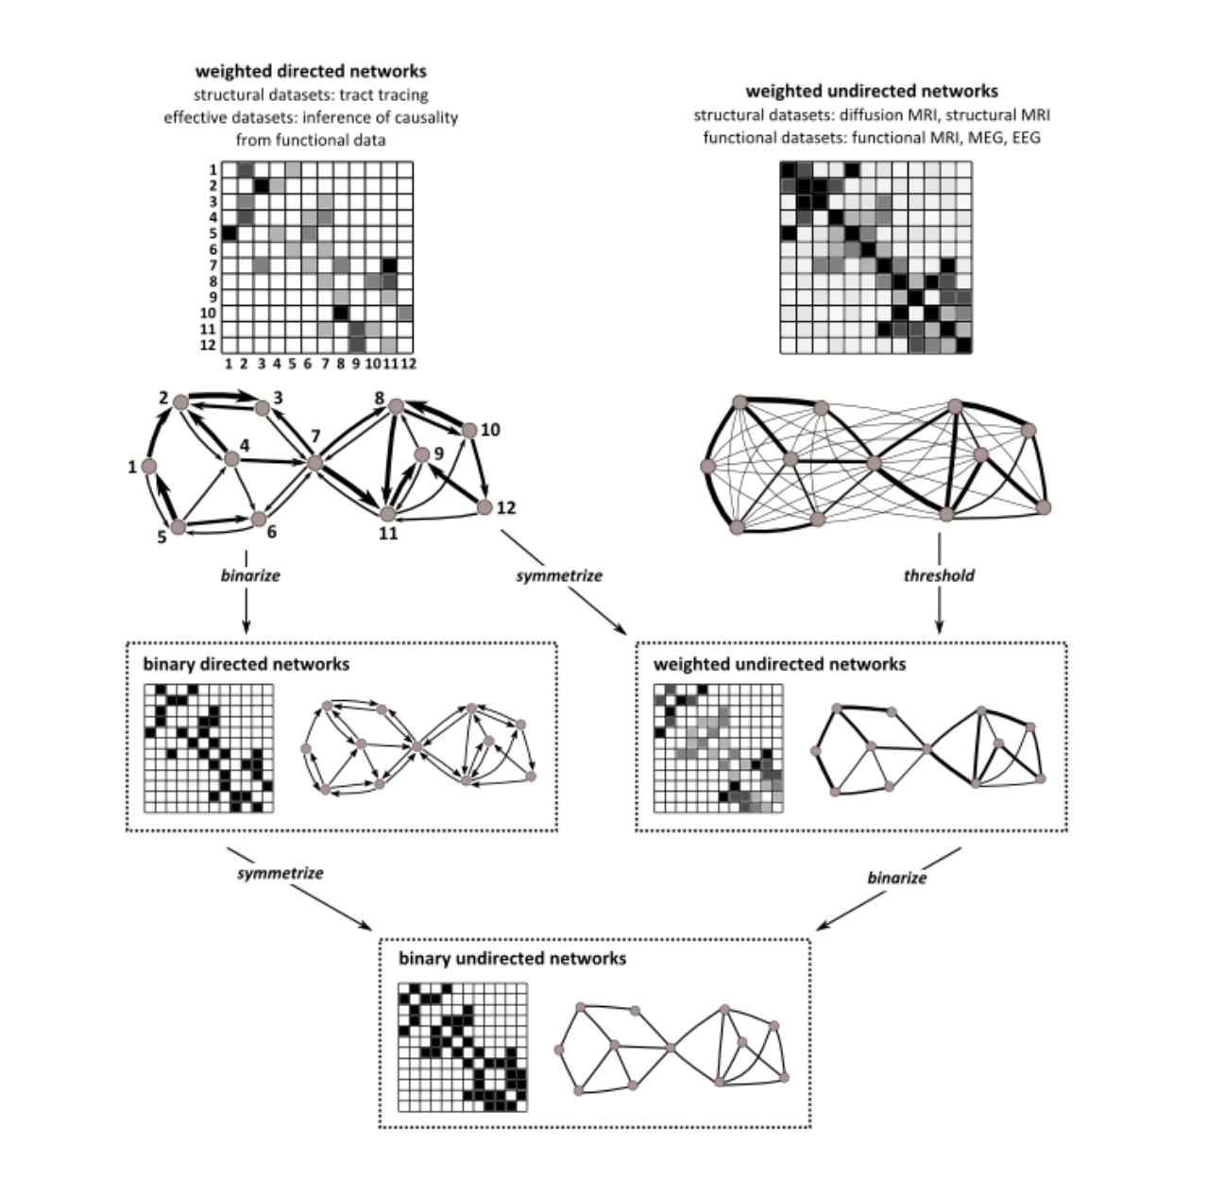
Tools and Derivatives: BCT (Rubinov & Sporns 2010)
Brain connectivity toolbox in Matlab
“.mat” files (hdf5 under the hood)
Not doing preprocessing or stats here

Slide 9
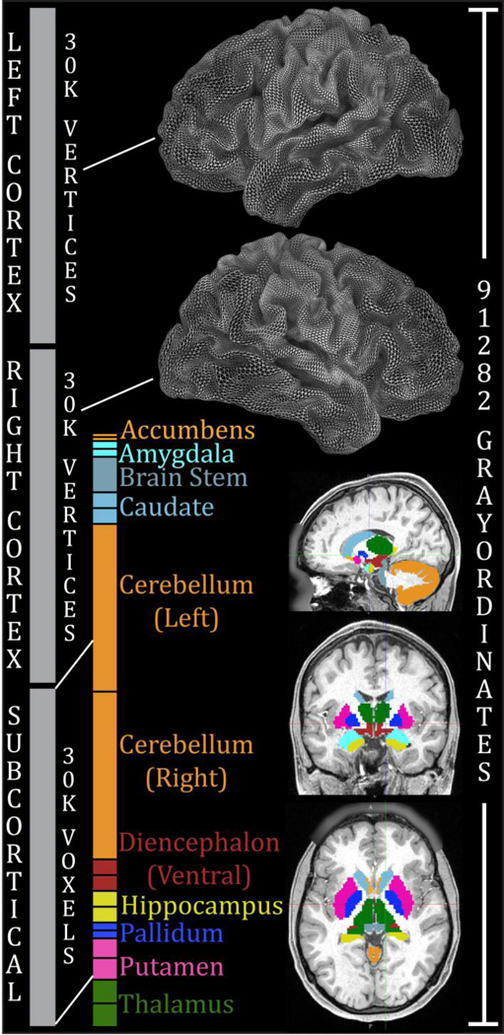
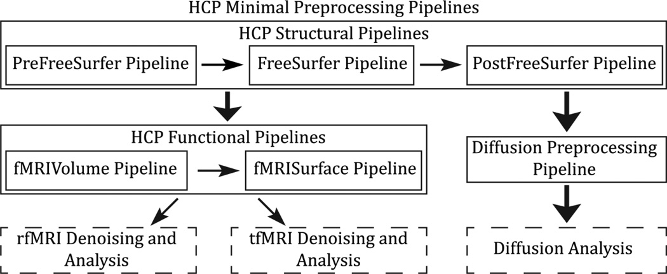
Tools and Derivatives: HCP (Glasser et al., 2013)
CIFTI (Connectivity Informatics Technology Initiative)
Notes:
An XML based mesh of the brain

Slide 10
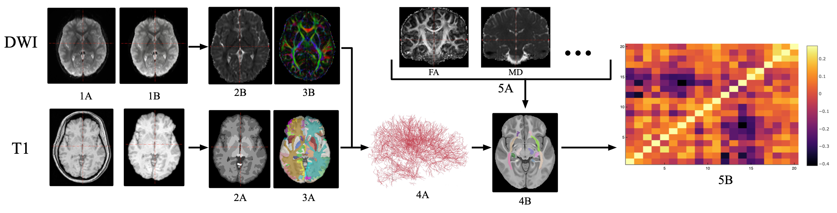
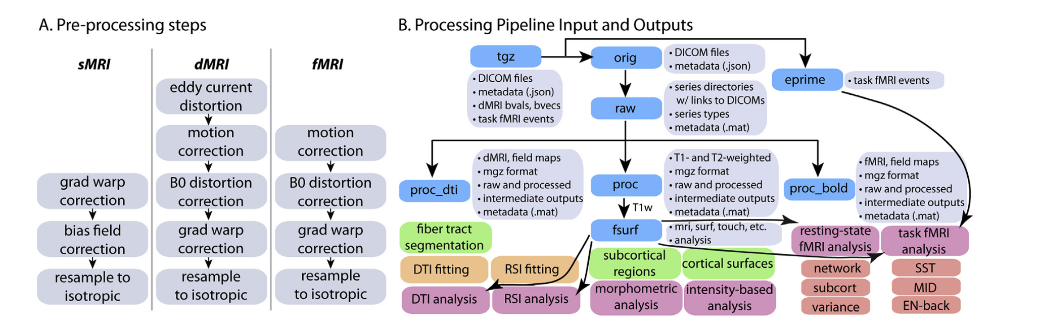
Adolescent Brain and Cognitive Development (ABCD) Study Pipeline
DTI + Structural connectomics pipeline (simplified)
Hagler et al., 2019

Slide 11
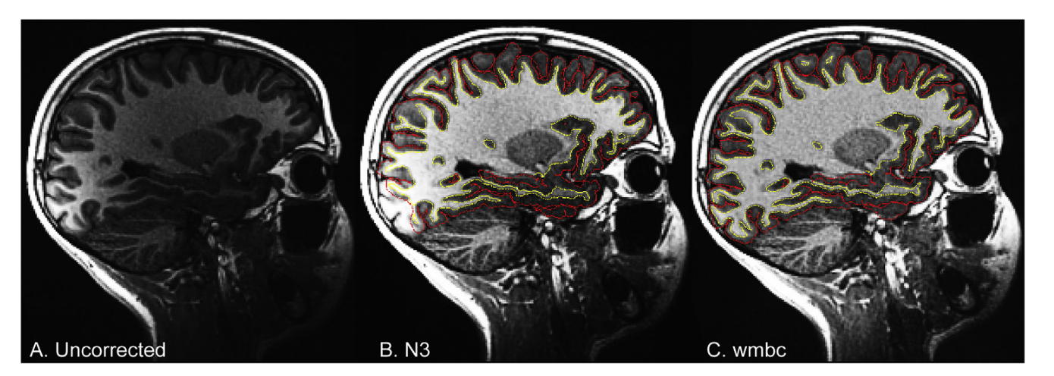
How to learn neuroimaging the right way?
No one pipeline is right
Variable methodologies produce divergent findings (Botvinik-Nezer, et al., 2020)
Highly reliable tractography =/= accurate tractography (Schilling et al., 2019)
Import to do but hard to know
Hagler et al., 2019
Notes:
70 independent teams to analyse the same dataset, testing the same 9 ex-ante hypotheses. Even cases where there were qualitative similarities in region and trend of findings yielded disagreement of dichotomous findings.
Submissions were able to reconstruct most of the ground truth bundles, with over 70% of submissions reconstructing 23 or more of the 25 valid pathways. However, tractography pipelines again had poor recovery of the spatial extent of bundles, with mean overlap values of only 36% of the true volumes.

Slide 12

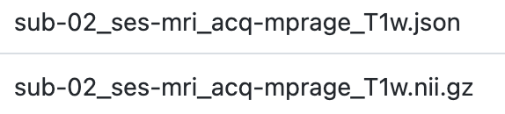
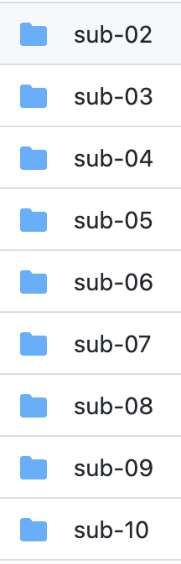


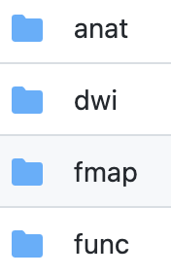
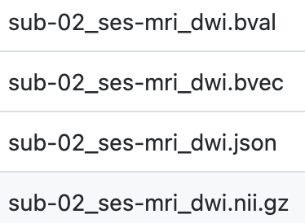

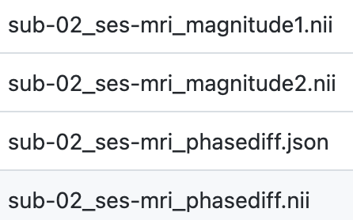
Brain Imaging Data Structure (BIDS) Specification (Gorgalewski et al., 2016)

Slide 13
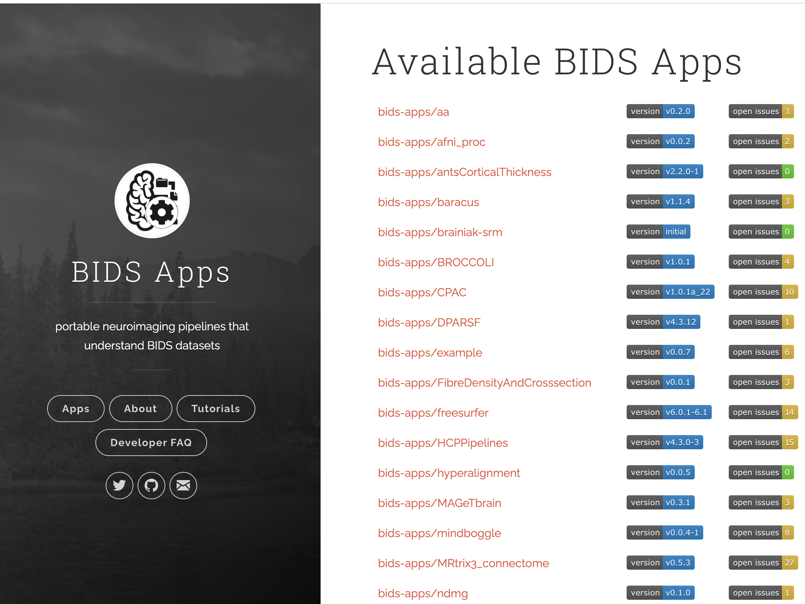
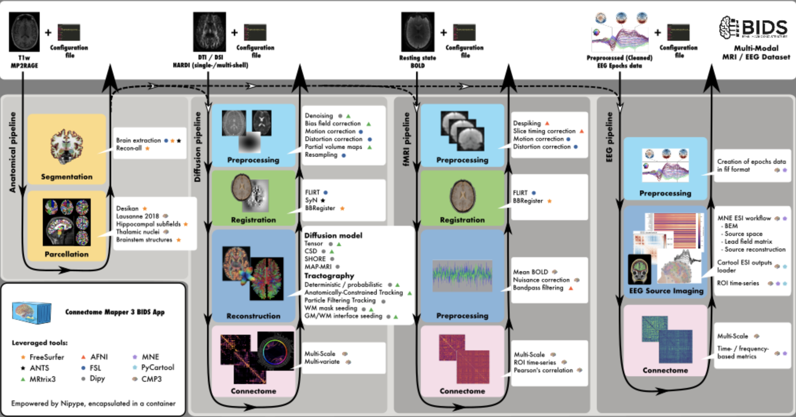
Common starting point for pipelines
(Tourbier et al., 2022)

Slide 14
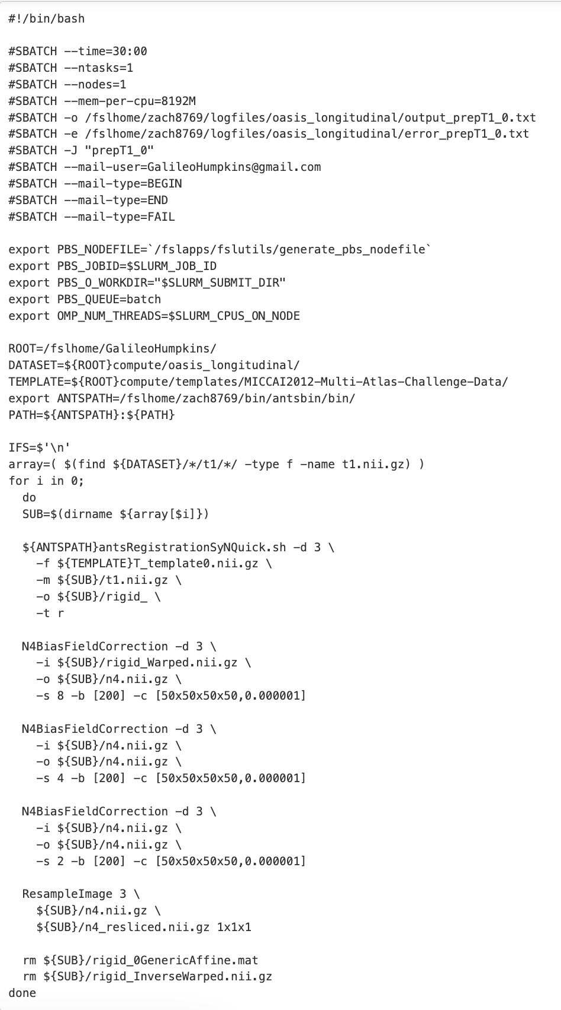
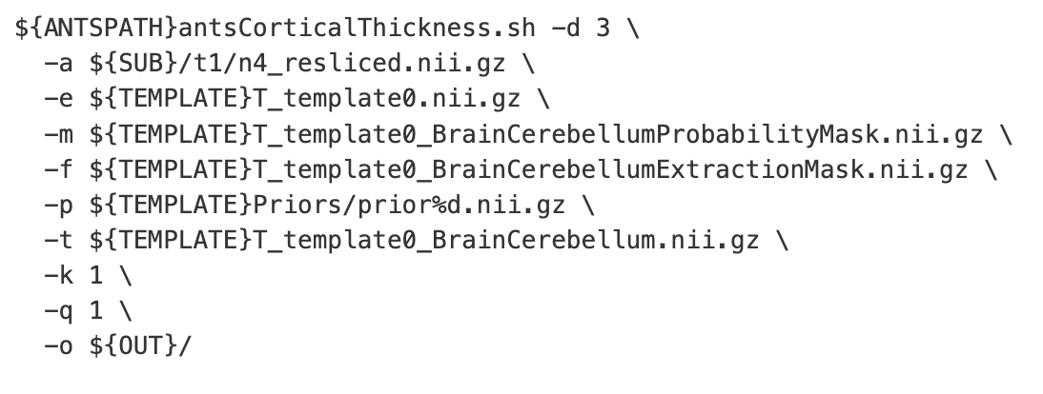
First Learn Bits, then Pipelines

Slide 15
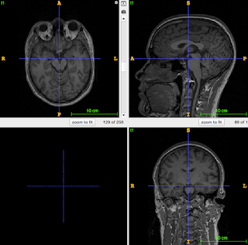
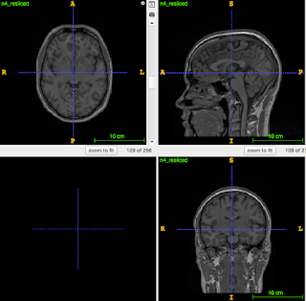
N4Bias Correction

Slide 16
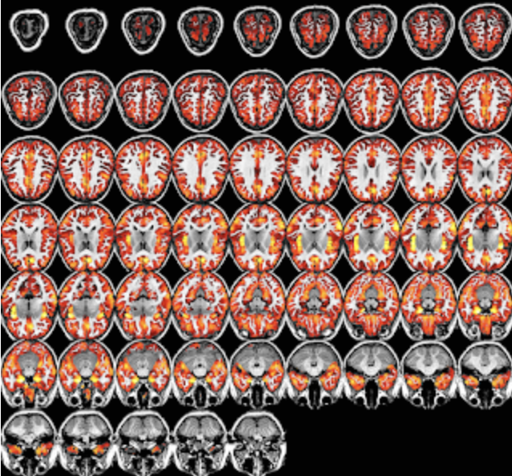
Segmentation

Slide 17
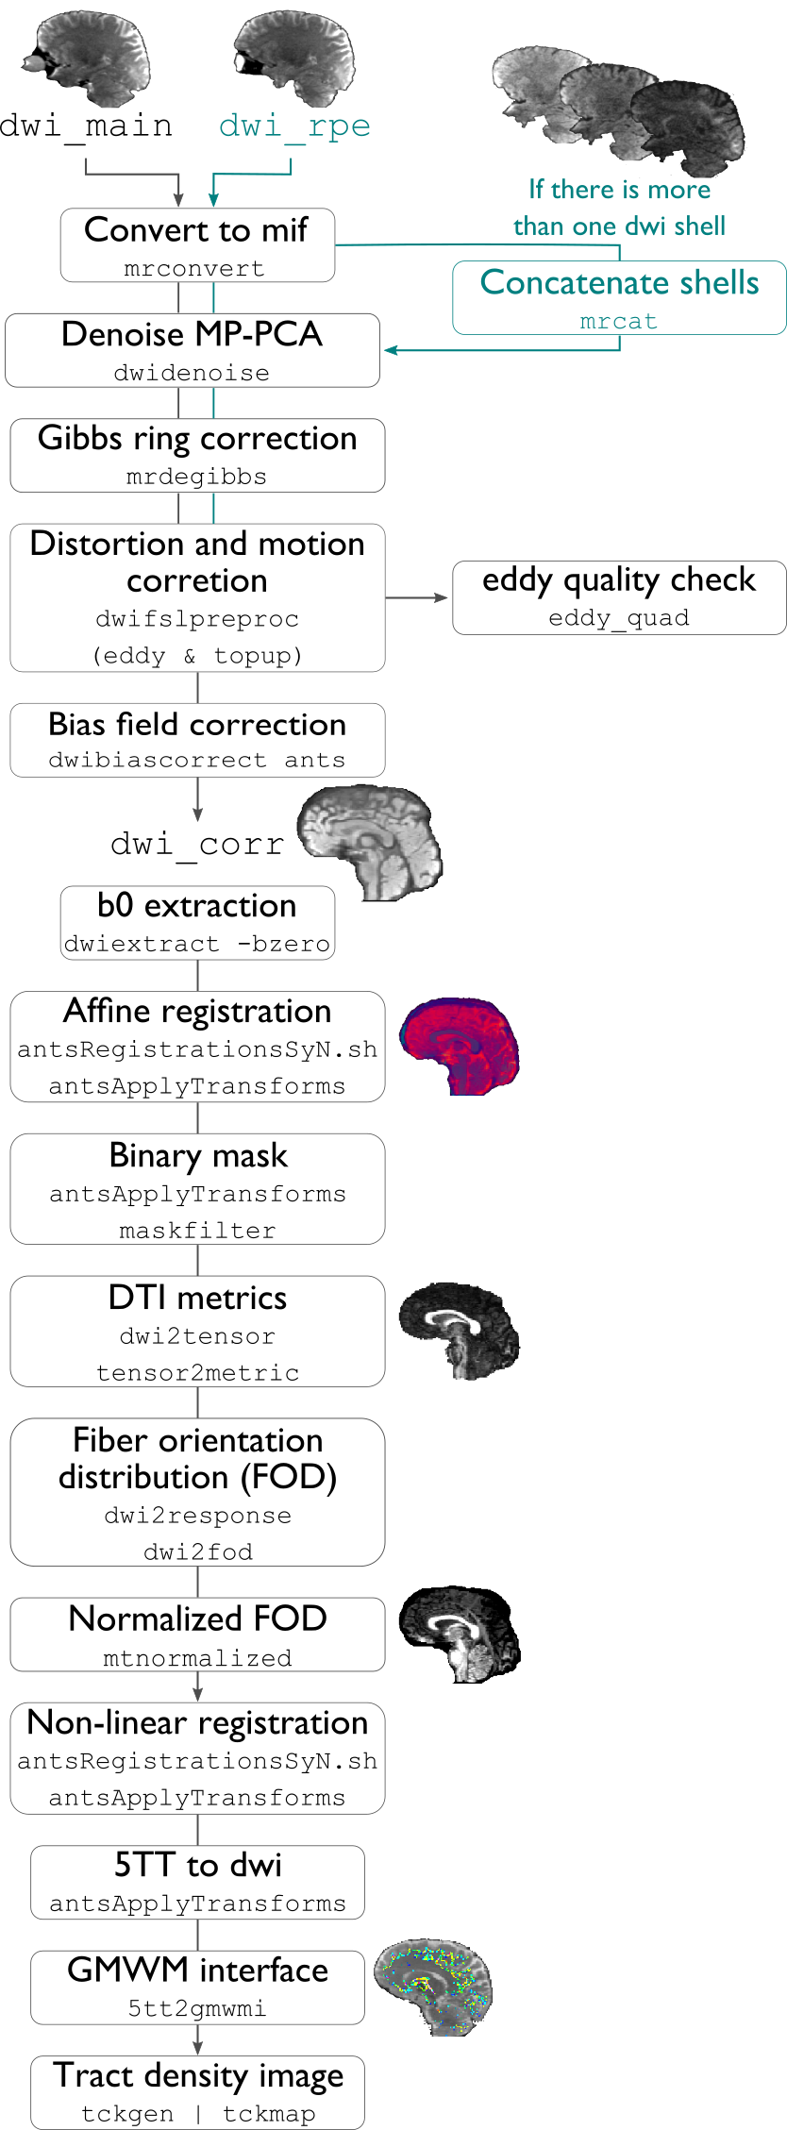
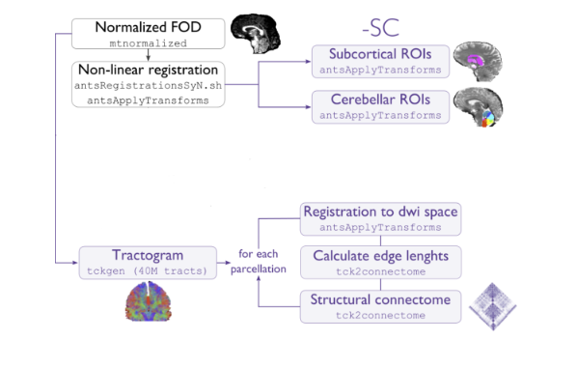

Slide 18
T1 Acquisition
DWI Acquisition
Bias Correction
Eddy Correction
EEG
Rigid Affine
DTI/NODDI/etc. Modeling
fMRI
Segmentation
Genetics
ROIs
DWI Derivative Measures
Deterministic tractography
Task data
Co-registration
Structural connectome
Cognitive testing
Method for analyzing fiber tracts
Collaborations
Mathematics
Biophysics
MRI
CT
Electrophysiology
High performance computing
Epidemiology
Geneticists
Biology
Fiber tract measure relevant to IQ
Easily replicable
Predictive modelling of dementia
Clinical integration
Identifying high risk patients

